Slide 1


Design and Implementation of high speed UART for Communication systems
05-03-2025

Slide 2
INTRODUCTION
In modern communication systems, efficient data transfer is crucial.
The Universal Asynchronous Receiver/Transmitter (UART) is a widely used protocol for serial communication between devices like microcontrollers, computers, and embedded systems.
Traditional UARTs, while reliable, often fall short in meeting the demands of high-speed data applications.
The design and implementation of high-speed UARTs aim to address these limitations by providing faster data transfer rates without compromising data integrity.
This advancement is vital for applications requiring rapid and reliable data communication, including real-time data processing, high-frequency trading systems, and advanced embedded systems.
By optimizing both hardware and software components, high-speed UARTs significantly enhance communication efficiency and performance.

Slide 3
OBJECTIVEs
Develop a UART system with significantly higher data transfer rates.
Implement robust error detection and correction mechanisms.
Design for power efficiency suitable for low-power applications.
Maintain backward compatibility with existing UART protocols.
Reduce transmission and reception latency for real-time data processing.
Create a scalable design adaptable to various data rates.
Rigorously test the UART under various conditions.
Use Vivado 2018.3 for accurate simulation and synthesis.

Slide 4
LITERATURE SURVEY
AUTHOR | TITLE OF THE PROJECT | PROBLEM STATEMENT | FEATURE EXTRACTION
Rahul Sonwane , Atul Deshmukh and Swapna Choudhary IEEE CONFERENCE 2023 | UART (Universal Asynchronous Receiver Transmitter) for Serial Data Communication: Design and Implementation on FPGA Platform | The problem lies in effectively implementing and verifying a Universal Asynchronous Receiver-Transmitter (UART) system on an FPGA, incorporating key components such as the transmitter, receiver, FIFO buffer, and baud rate generator. The challenge is to ensure reliable data transmission and prevent data loss. This work aims to address these issues by designing a UART in Verilog, simulating and synthesizing it with Xilinx ISE 14.7, and validating it on the Spartan-3E FPGA board. | UART implementation on a Xilinx Spartan 3E FPGA board was successful. Depending on the information received by Spartan 3E, the output LED will change. Since a FIFO buffer is utilised to prevent data loss, the design has a high degree of flexibility and integration. Less than 10% of the total number of slices are needed if the design has already been prepared. Slice Flip Flops are 1%, there are 3% total LUTs with 4 inputs, and there are 3% occupied slices. The resource for this design is little.

Slide 5
LITERATURE SURVEY
AUTHOR | TITLE OF THE PROJECT | PROBLEM STATEMENT | FEATURE EXTRACTION
Lehan Cao , Jianfeng Chen and Jincheng Li IEEE CONFERENCE 2023 | Working principle and application analysis of UART | Despite its maturity and advantages such as low cost and reliability, UART (Universal Asynchronous Receiver-Transmitter) faces significant limitations, including lower data transmission rates, cumbersome baud rate error adjustments, and inadequate resistance to interference. These shortcomings restrict its effectiveness in high-performance and noise-sensitive applications. Addressing these issues presents a challenge and opportunity for advancing UART technology to enhance its performance and versatility. | The article highlights UART's maturity and widespread use in fields like military and communications due to its high speed, low power, and reliability. Despite these advantages, UART faces challenges such as slower speeds, complex baud rate settings, and limited anti-interference. Future improvements are needed to enhance its performance and address these limitations.

Slide 6
LITERATURE SURVEY
AUTHOR | TITLE OF THE PROJECT | PROBLEM STATEMENT | FEATURE EXTRACTION
Wenyu Wang IEEE CONFERENCE 2023 | Optimization of UART Communication Protocol Based on Frequency Multiplier Sampling Technology and Asynchronous FIFO | The problem addressed is the inefficiency and complexity of traditional UART designs, particularly in handling asynchronous data transmission across different clock domains and rates, synchronization issues, and data buffering. This work aims to resolve these issues by implementing asynchronous FIFO, data buffering, optimized sampling, and frequency multiplication techniques. The improved UART design, simulated in ModelSim SE64, seeks to enhance transmission efficiency, reduce bit error rates, and improve anti-interference. | All code is in Verilog HDL for clear simulation semantics and validated with Modelsim SE-64. Communication network control system simulation is done in MATLAB R2022a. The method is developed step by step, addressing deficiencies and refining the model.

Slide 7
LITERATURE SURVEY
AUTHOR | TITLE OF THE PROJECT | PROBLEM STATEMENT | FEATURE EXTRACTION
Dong An , Zhouming Guo and Kehan Zhao IEEE CONFERENCE 2024 | Design of UART Communication System Based on Adaptive Baud Rate Technology | In IoT applications, UART communication often requires fixed baud rates, which are difficult to change once set. This paper proposes a UART system with adaptive baud rate technology, enabling dynamic detection and adjustment of baud rates for flexible, efficient communication without prior agreement. This approach simplifies implementation, improves speed, and reduces resource usage, as shown through software simulations. | The paper presents a UART design with adaptive baud rate detection, improving serial communication by automatically adjusting baud rates. Validated through simulations at 9600, 19200, and 38400 bps, future work will enhance precision, reduce power consumption, add error correction, and incorporate machine learning. This design aims to boost flexibility and reliability for IoT and embedded systems.

Slide 8
LITERATURE SURVEY
AUTHOR | TITLE OF THE PROJECT | PROBLEM STATEMENT | FEATURE EXTRACTION
Akash Gupta and Chhagan Charan IEEE CONFERENCE 2024 | Analysis of Universal Asynchronous Receiver-Transmitter(UART) | Despite advancements in UART technology, challenges remain in optimizing power consumption and enhancing transmission speed. Existing systems often struggle with maintaining data accuracy and performance under varying conditions. Addressing these issues is critical for the reliable integration of UART in modern communication networks. | UART, stands for Universal Asynchronous Receiver/Transmitter, is a popular known communication protocol in the embedded systems and electronics fields. It provides devices with an easy-to-use and efficient way to communicate, especially when serial data transmission is needed. To put it simply, UART is a extensively used and adaptable communication protocol that meets the various requirements of electronics devices and embedded systems. Its simplicity, compatibility, and simplicity of implementation make it a desirable option for many kinds of applications, especially when it built-in qualities match the unique communication requirements at hand.

Slide 9
LITERATURE SURVEY
AUTHOR | TITLE OF THE PROJECT | PROBLEM STATEMENT | FEATURE EXTRACTION
Mayank Trehan , Pradeep Kumar and Nidhi Gaur IEEE CONFERENCE 2024 | Design and Analysis of Multi-Protocol Conversion Unit for SPI, I2C and UART | Efficient communication between devices using different serial protocols (SPI, I2C, UART) is challenging and often requires microprocessors for data conversion, leading to increased processing overhead. The problem is to design a Multi-Protocol Conversion Unit (MPCU) that seamlessly converts data between these protocols, minimizing the need for microcontroller involvement and improving system efficiency. 4o mini | The MPCU design effectively performs data conversions between SPI, I2C, and UART protocols using a COSE signal. It operates seamlessly, reducing computation time, operations, and power consumption compared to using a microcontroller. This prototype is valuable for industrial applications, especially in prototyping and one-way data conversion. Future enhancements could include support for reverse data conversion, further reducing microcontroller workload and improving flexibility.

Slide 10
LITERATURE SURVEY
AUTHOR | TITLE OF THE PROJECT | PROBLEM STATEMENT | FEATURE EXTRACTION
Timothy Simon Thomas , Arun Singh , Shyam Ramanathan , and Sunil Rafeeque IEEE TRANSACTIONS ON CIRCUITS AND SYSTEMS JOURNAL 2024 | A Novel Channel-Aware, Non-Sampling UART With Augmented Clock Frequency Resilience | Develop a UART architecture using timeouts and edge-related information for frame decoding to enhance resilience to clock frequency variations. Utilize a lower frequency clock and implement compensation for channel distortions like rise and fall times. Aim to improve reliability and efficiency in serial communication. 4o | The novel UART architecture features a lower operating frequency and introduces channel-aware auto-baud detection. It eliminates the need for sampling by utilizing preamble-derived parameters, reducing sensitivity to clock frequency accuracy and achieving a robust and efficient design. The architecture was successfully tested on both ASIC and FPGA platforms.

Slide 11
EXISTING SYSTEM
Purpose and Usage :
UART is widely used for serial data communication in modern communication systems and
embedded systems.
It facilitates efficient and straightforward serial data transmission between devices.
Modes of Operation :
Half-Duplex , Full-Duplex
Data Transmission Format :
Typically transmits one byte of data at a time.
Format: Usually 10 or 11 bits per frame, which includes:
8 data bits
1 start bit ,1 stop bit ,1 optional parity bit (used for error detection)

Slide 12
Asynchronous Communication :
Operates without a shared clock signal, relying on pre-defined baud rates for synchronization
Known for its simplicity and stable design.
Features and Improvements:​
Error Detection: Includes mechanisms like parity checking for basic error detection.​
Baud Rate Options: Configurable baud rates allow flexibility in communication speed.​
Flow Control: Supports hardware (e.g., RTS/CTS) and software (e.g., XON/XOFF) flow control to . . . manage data flow and prevent loss.​
Overall Appeal:​
UART’s adaptability and built-in features make it a desirable option for many applications.​
Its straightforward design and reliable performance cater to various communication requirements in
electronics devices and embedded systems.​

Slide 13
PROPOSED WORK
Increasing the baud rate and clock frequency in UART to achieve high-speed data sharing involves several key steps, ensuring both hardware and software configurations are optimized for the new settings.
Objective
Develop a configurable N-bit UART communication system using Verilog HDL.
Ensure reliable and efficient serial data transmission.
Implement error detection for improved data integrity.
Up to 1Mbps speed.

Slide 14
System Components
UART Transmitter: Converts N-bit parallel data into a serial data stream.
UART Receiver: Converts received serial data back into N-bit parallel format.
Baud Rate Generator: Maintains accurate timing synchronization between transmitter and receiver.
Key Features
Supports N-bit Data Transfer: Configurable bit-width (e.g., 8-bit, 16-bit, 32-bit,…..).
Asynchronous Communication: No shared clock signal is required.
Start & Stop Bits: Ensures proper framing and synchronization.
Configurable Baud Rate: (e.g., 9600, 19200, etc.).
Error Detection: Parity bit for detecting transmission errors.

Slide 15
Data Transmission Process
Transmitter loads N-bit parallel data and converts it into serial format.
Baud rate generator ensures correct transmission speed for different baud rates.
Receiver detects the start bit, samples N-bits, checks the stop bit, and reconstructs the original data.
Advantages of Proposed Work
Flexible N-bit Support: Can handle different data sizes (e.g., 8-bit, 16-bit, 32-bit).
Reliable Communication: Proper bit alignment ensures error-free transmission.
Scalable & Efficient: Optimized Verilog design for varying data widths.
Error Detection: Ensures data integrity and reduces transmission errors.

Slide 16


Software Configuration
Vivado 2018.3
Setting System Clock
Method: Using direct register programming to set the system clock frequency.
Baud Rate Calculation
Calculate Baud Rate Divider:
​
Determine Baud Rate Divider:
Select Closest Divider: Choose the closest integer value for the divider that matches the desired baud rate as closely as possible.

Slide 17
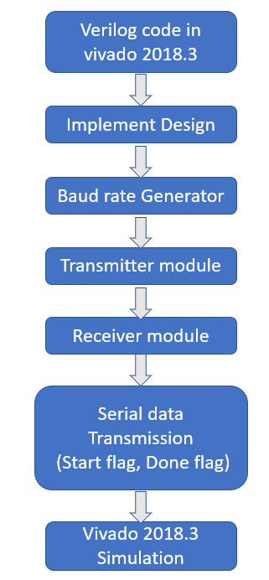
FLOW CHART

Slide 18
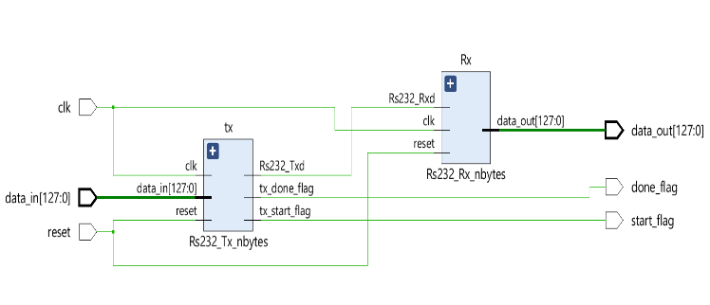
Schematic diagram

Slide 19
Work done
Designed and Implemented UART Communication System
Developed a Universal Asynchronous Receiver/Transmitter (UART) using Verilog HDL.
Implemented transmitter and receiver modules for serial communication.
Added N-Bit and baudrate Configurable Data Transmission
Enhanced the system to support N-bit parallel data transmission instead of a fixed 8-bit format.
The system can now handle variable data sizes (e.g., 8-bit, 16-bit, 32-bitand upto 128 bit).
The system can handle Baud rate upto 1mbps
Verified System Performance
Simulated UART functionality using testbenches.
Ensured proper data serialization and deserialization for different N-bit configurations.
Validated error detection mechanisms for data integrity.

Slide 20
BAUD RATE CALCULATION
Clock frequency 50MHZ
For 9600
Clock frequency
Baud rate divider =
Baud rate * 16
50 * 10
=
9600 * 16
= 325.5
Converting in Hexa decimal
For 9600 = (325.5)10 = (145.8)16
6

Slide 21
BAUD RATE CALCULATION
For 19200
Clock frequency
Baud rate divider =
Baud rate * 16
50 * 10
=
19200 * 16
= 162.760
Converting in Hexa decimal
For 9600 = (162.760)10 = (A2.C2)16
6

Slide 22
BAUD RATE CALCULATION TABLE
S.NO | BAUD RATE | BAUD RATE DIVIDER
1 | 9600 | 145.8
2 | 19200 | A1.C2
3 | 38400 | 51.61
4 | 57600 | 36.40
5 | 115200 | 1A.10

Slide 23
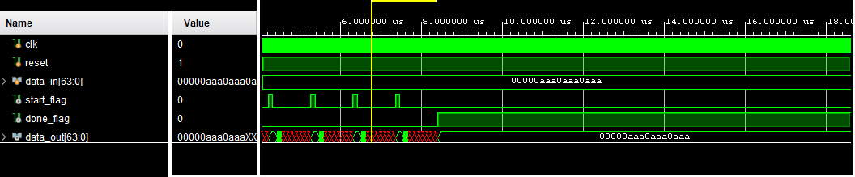
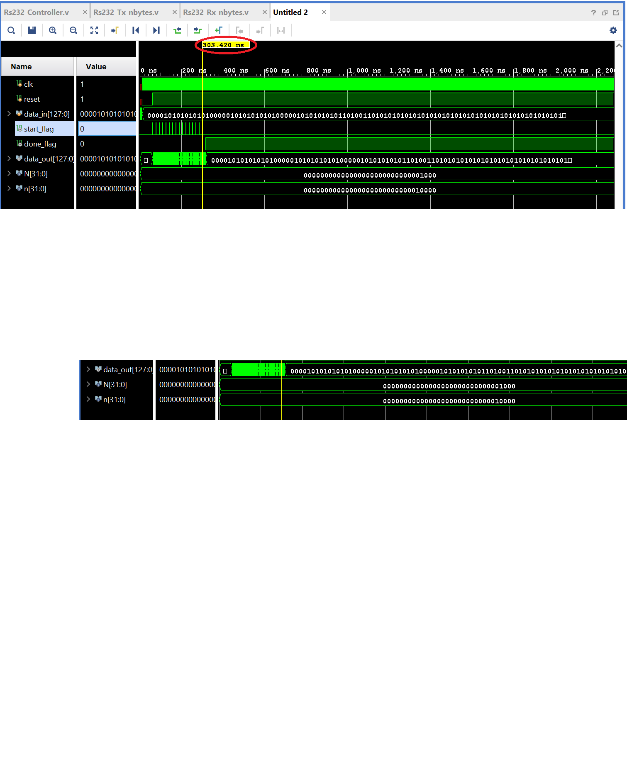
Work done RESULT

Slide 24
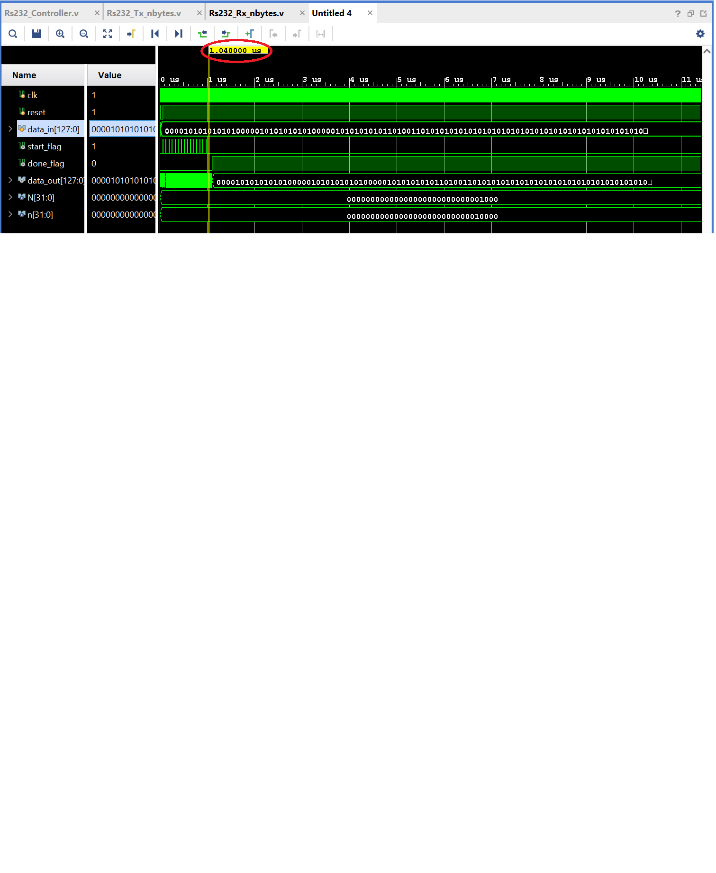
Work done RESULT
4600 Baud rate

Slide 25
Work done RESULT
19200 Baud rate

Slide 26
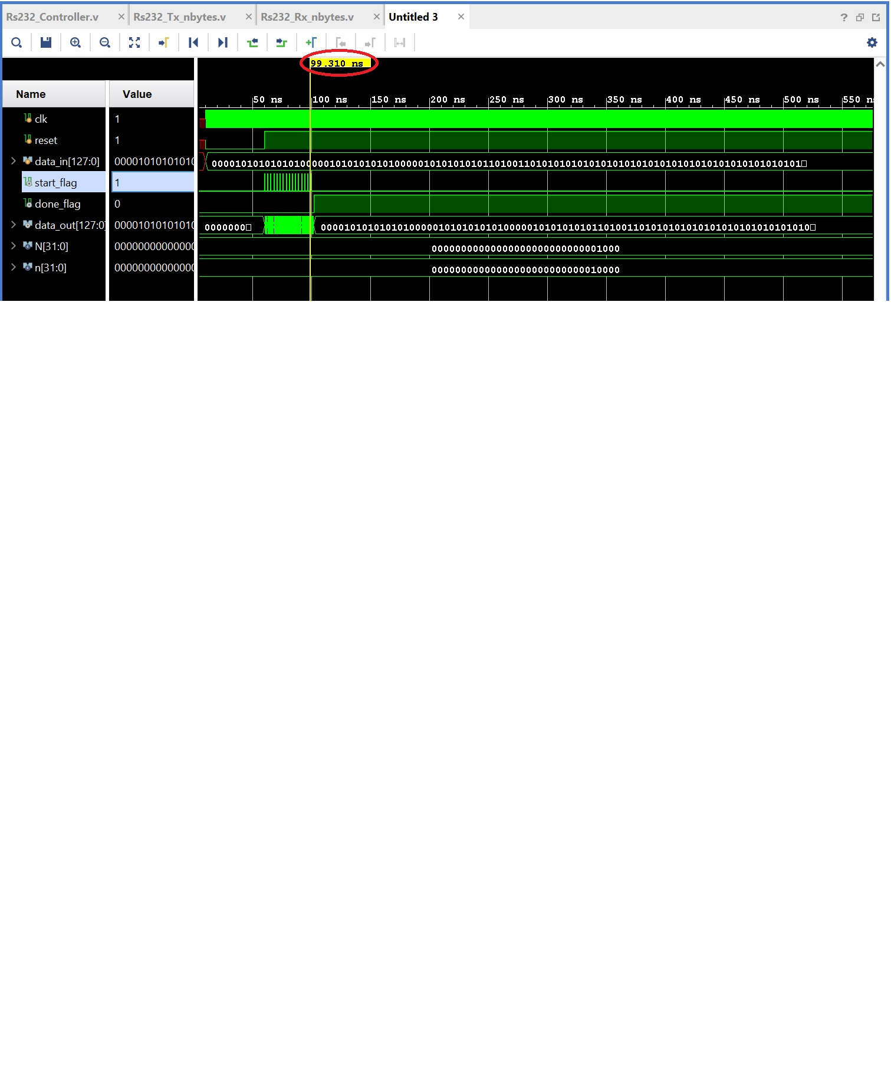
Work done RESULT
115200 Baud rate

Slide 27
RESULT
S.NO | BAUD RATE | SPEED
1 | 4600 | 1.04 micro seconds
2 | 19200 | 303.04 nano seconds
3 | 38400 | 220.03 nano seconds
4 | 57600 | 178.05 nano seconds
5 | 115200 | 99.310 nano seconds

Slide 28
Conclusion
In this project, we successfully designed and implemented a high speed Universal Asynchronous Receiver/Transmitter (UART) communication protocol using Verilog Hardware Description Language (HDL).
The system was composed of two key modules: a transmitter for converting parallel data into serial form with proper framing, and a receiver for capturing the serial data, verifying its integrity, and converting it back to parallel form.
A baud rate generator operating at speeds of up to 1 Mbps ensured accurate timing and synchronization between the transmitter and receiver, enabling reliable data transmission.
The implementation demonstrated the feasibility of UART communication for efficient data transfer between devices, successfully transferring n bits of data from the master to the slave.
This UART communication protocol proves to be a robust and adaptable solution for a variety of real-time applications, offering flexibility for both simple and complex data transmission needs.
It provides a foundation for future enhancements, such as higher data rates and multi-bit configurations, further improving the scalability and performance of the UART communication system.

Slide 29
REFERENCES
[1] Sardi Irfansyah “Design and implementation of UART with FIFO buffer using VHDL in FPGA” ICTACT JOURNAL ON MICROELECTRONICS, APRIL 2019, VOLUME: 05, ISSUE.
[2] U. Nanda and S. K. Pattnaik, “Universal Asynchronous Receiver and Transmitter (UART),” 3rd International Conference on Advanced Computing and Communication Systems (ICACCS), vol. 1, pp. 1-5, 2016.
[3] Y. Fang and X. Chen, “Design and Simulation of UART Serial Communication Module Based on VHDL,” 3rd International Workshop on Intelligent Systems and Applications, pp. 1-4, 2011
[4] U. Nanda and S. K. Pattnaik, “Universal Asynchronous Receiver and Transmitter (UART),” 3rd International Conference on Advanced Computing and Communication Systems (ICACCS), vol. 1, pp. 1-5, 2016.
[5] Poorani, M. and Kurunjimalar, R., “Design implementation of UART and SPI in single FGPA”. In 2016 10th International Conference on Intelligent Systems and Control (ISCO), pp. 1-5, 2016

Slide 30
THANK YOU

